Slide 1

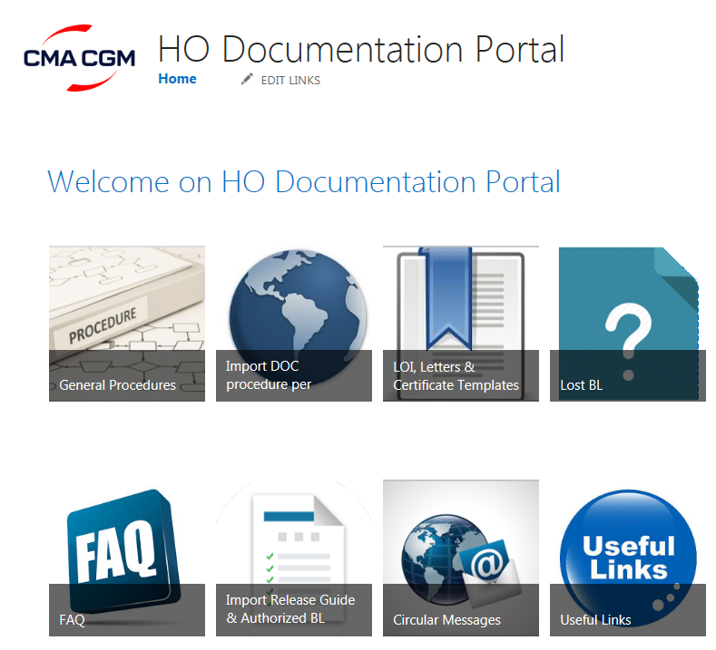
HO DOC Team Site – How to subscribe?
Go to HO DOC Sharepoint page:
https://teamsite.cma-cgm.com/sites/HODOC/SitePages/HO%20Documentation%20Portal.aspx
HO Documentation team

Slide 2
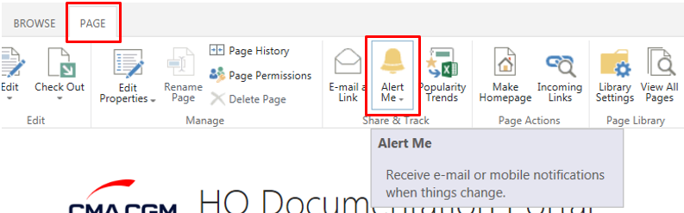
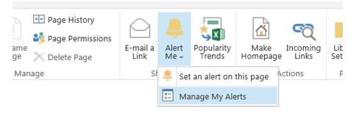
HO DOC Team Sites – How to subscribe?
Click on “PAGE” – “Alert me” option on the top bar menu
Select option - “Manage my Alerts”
HO Documentation team

Slide 3
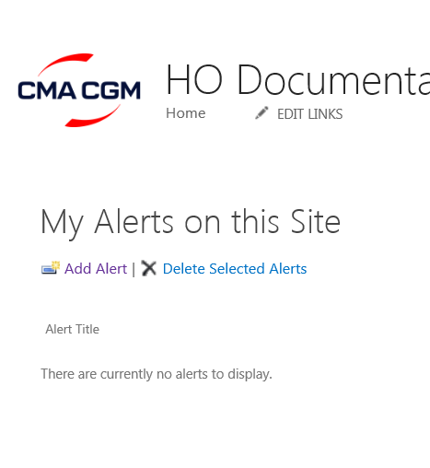
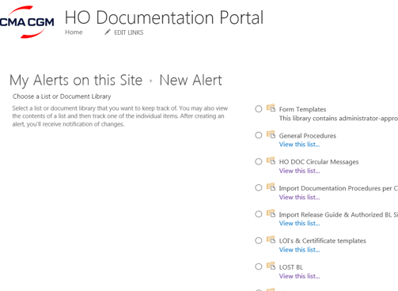
HO DOC Team Sites – How to subscribe?
1
Click on- “Add Alert”
A list will be displayed
HO Documentation team

Slide 4
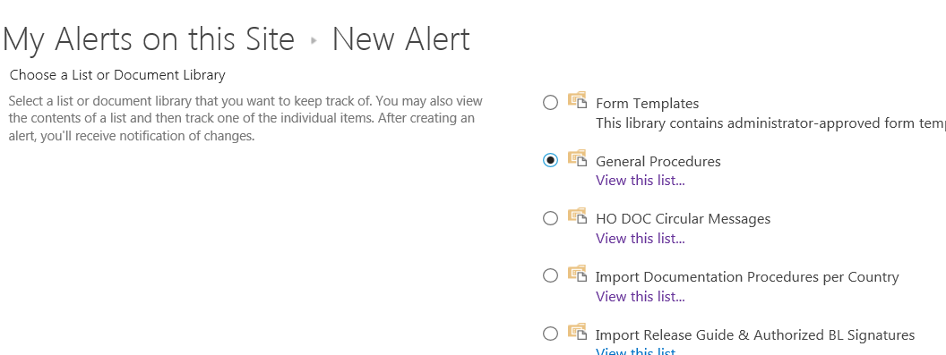
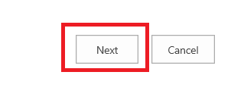
HO DOC Team Sites – How to subscribe?
2
Select the one for which you want to receive alerts (only 1 selection possible at a time)
Ie: “General Procedures”
Then click on Next (at the bottom right)
HO Documentation team

Slide 5
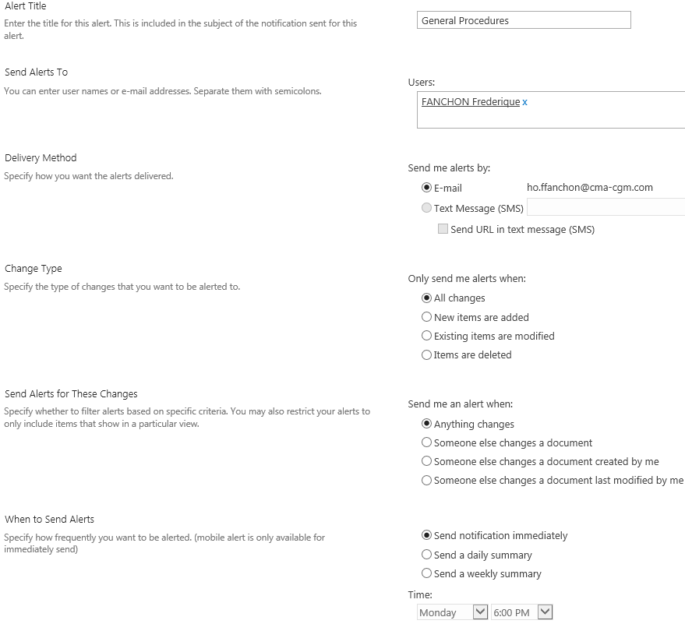

HO DOC Team Sites – How to subscribe?
Set up the parameters according to your preference:
3
And click on OK
HO Documentation team

Slide 6
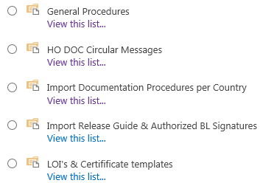



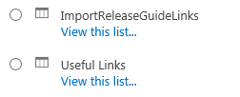
HO DOC Team Sites – How to subscribe?
Repeat the same operation for all pages for which you want to receive an alert.
We recommend to set alerts on all below listed items:
HO Documentation team

Slide 7
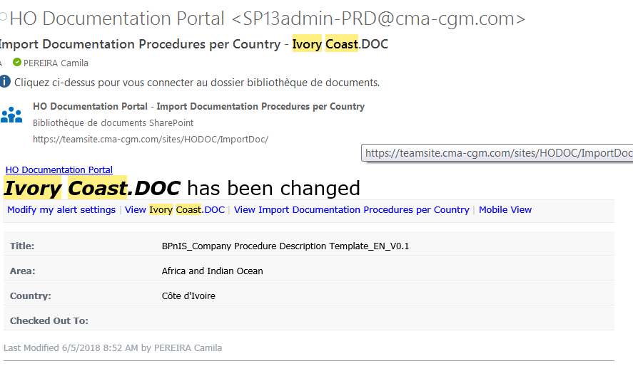
HO DOC Team Sites – How to subscribe?
You will receive an e-mail automatically from Sharepoint, alerting you for procedures updates.
HO Documentation team

